Slide 2
Computational approaches for the therapeutic target discovery to ame-liorate muscle wasting during aging and disease
Msc Karen Guerrero Vazquez
Dr. Katarzyna Whysall
Dr. Pilib O Broin

Slide 3
Update # 3

Slide 4
Content
Summary
Pathway analysis
MicroArray analysis
Network analysis
Notes:
We mentioned that aging have a lot of factors attached to it, in the specific case of Sarcopenia we can include chronic inflammation, increased reactive oxidative species, and increased fibrosis of muscle, among others have been reported to contribute to development of sarcopenia

Slide 5
Summary
Notes:
We mentioned that aging have a lot of factors attached to it, in the specific case of Sarcopenia we can include chronic inflammation, increased reactive oxidative species, and increased fibrosis of muscle, among others have been reported to contribute to development of sarcopenia

Slide 6
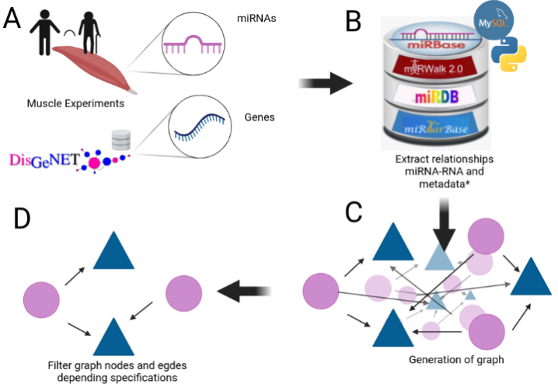
Notes:
We mentioned that aging have a lot of factors attached to it, in the specific case of Sarcopenia we can include chronic inflammation, increased reactive oxidative species, and increased fibrosis of muscle, among others have been reported to contribute to development of sarcopenia

Slide 7
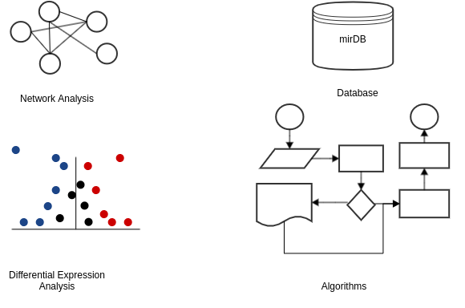
Key points

Slide 8



Expression during age
Middle age
Old
Young
<35>
<65>
Y
MA
O

Slide 9
Gene expression during aging
Young = (0, 35]
MA = (35,65)
Old = [65, inf)

Slide 10


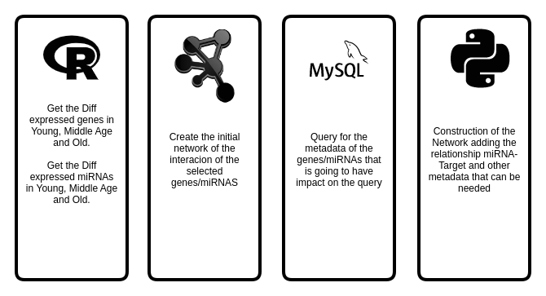

Key points

Slide 11
My Experiments
Target | Type | N. Experiments
mRNA | RNASeq | 3
 | MicroArray | 4
miRNA | MicroArray | 1
 | miRSeq | 2
Proteomics | - | 1

Slide 12
Update # 3

Slide 13

Experiment | Evaluation | Regulation | Genes
GSE152558 | MO | Down | 9
GSE152558 | MO | UP | 8
GSE157585 | YO | Down | 73
GSE157585 | YO | UP | 9
GSE164471 | OY | Down | 8
GSE164471 | OY | UP | 5
GSE164471 | MY | Down | 2
GSE164471 | MY | UP | 2
GSE164471 | MO | Down | 11
GSE164471 | MO | UP | 6
GSE875105 | OY | Down | 88
GSE875105 | OY | Up | 18
GSE875105 | MO | Up | 6
GSE23527 | YO | Down | 5
GSE23527 | YO | Up | 1
Notes:
We mentioned that aging have a lot of factors attached to it, in the specific case of Sarcopenia we can include chronic inflammation, increased reactive oxidative species, and increased fibrosis of muscle, among others have been reported to contribute to development of sarcopenia

Slide 14
Pathway Analysis

Slide 15
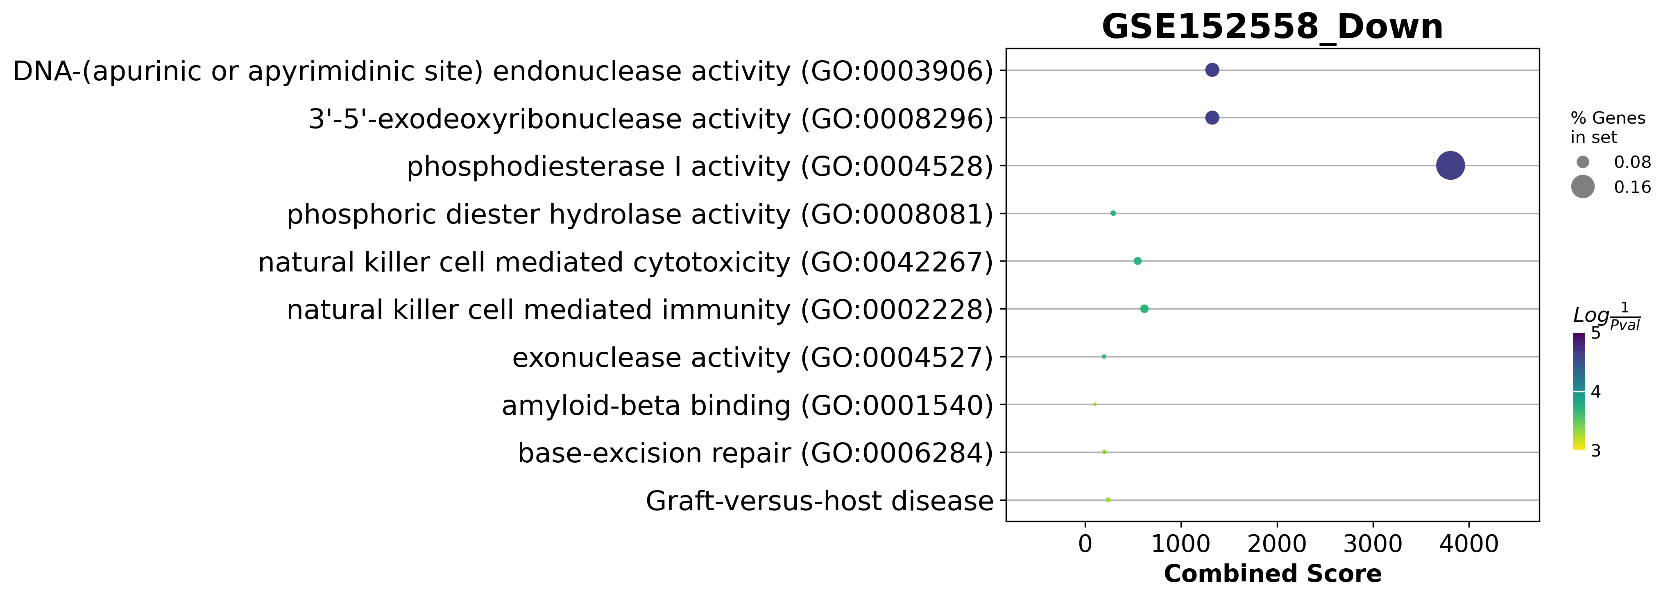
GSE152558 Dotplot

Slide 16
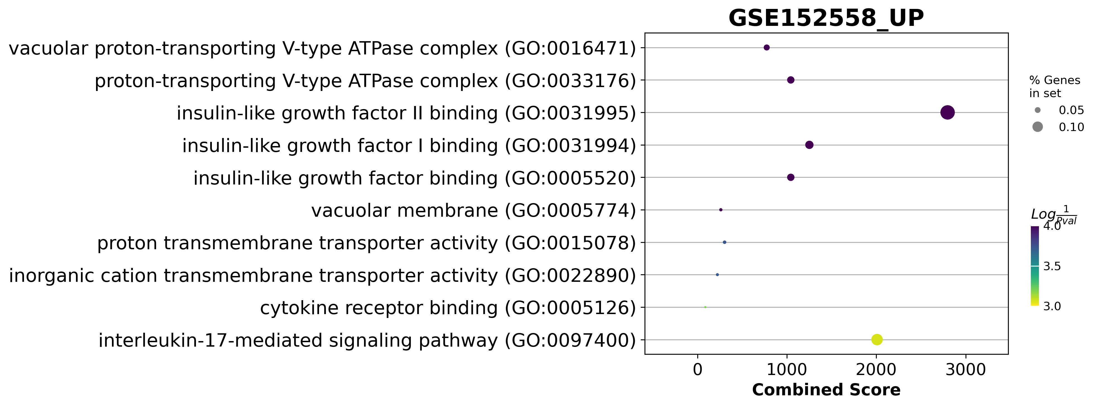
GSE152558 Dotplot

Slide 17
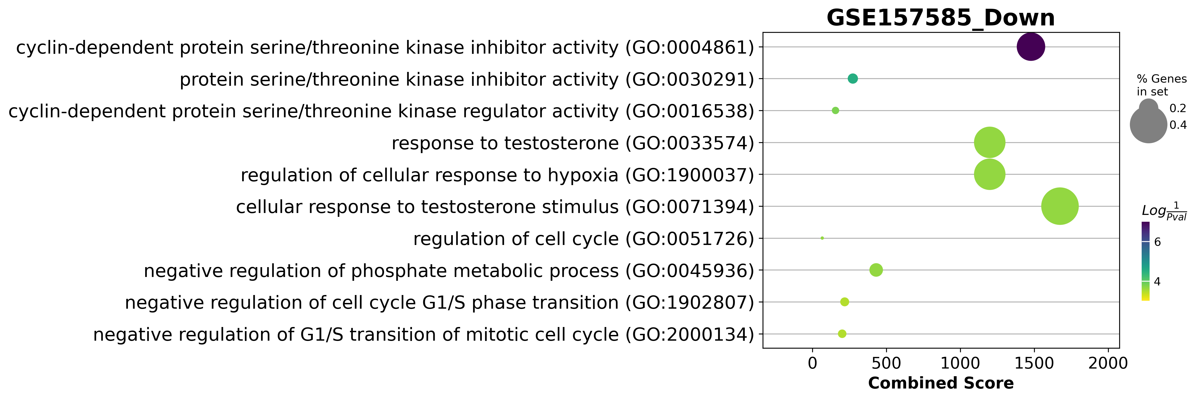
GSE157585 Dotplot

Slide 18
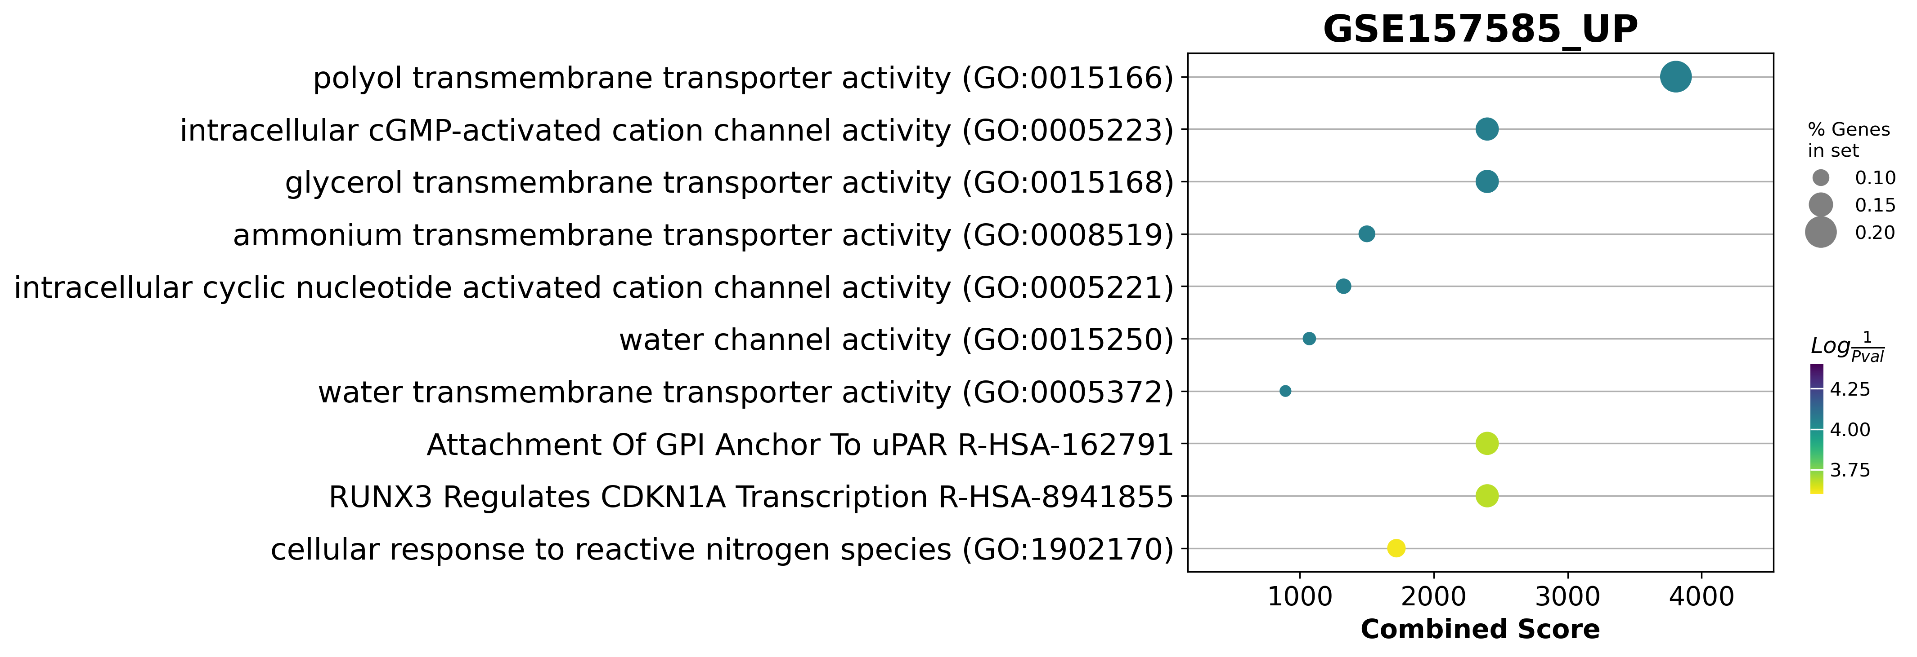
GSE157585 Dotplot

Slide 19
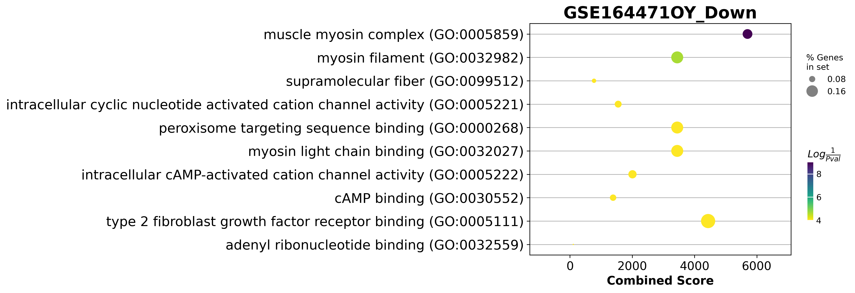
GSE164471 Dotplot

Slide 20
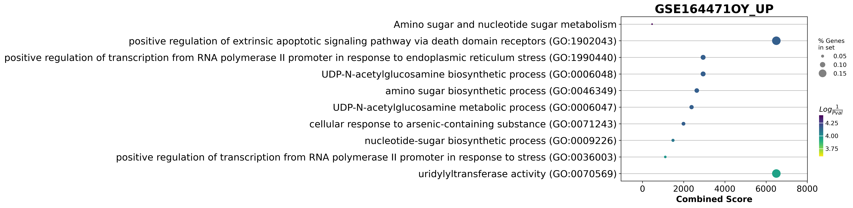
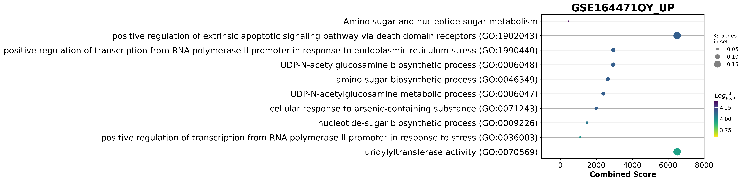
GSE164471 Dotplot
galactose to glucose

Slide 21
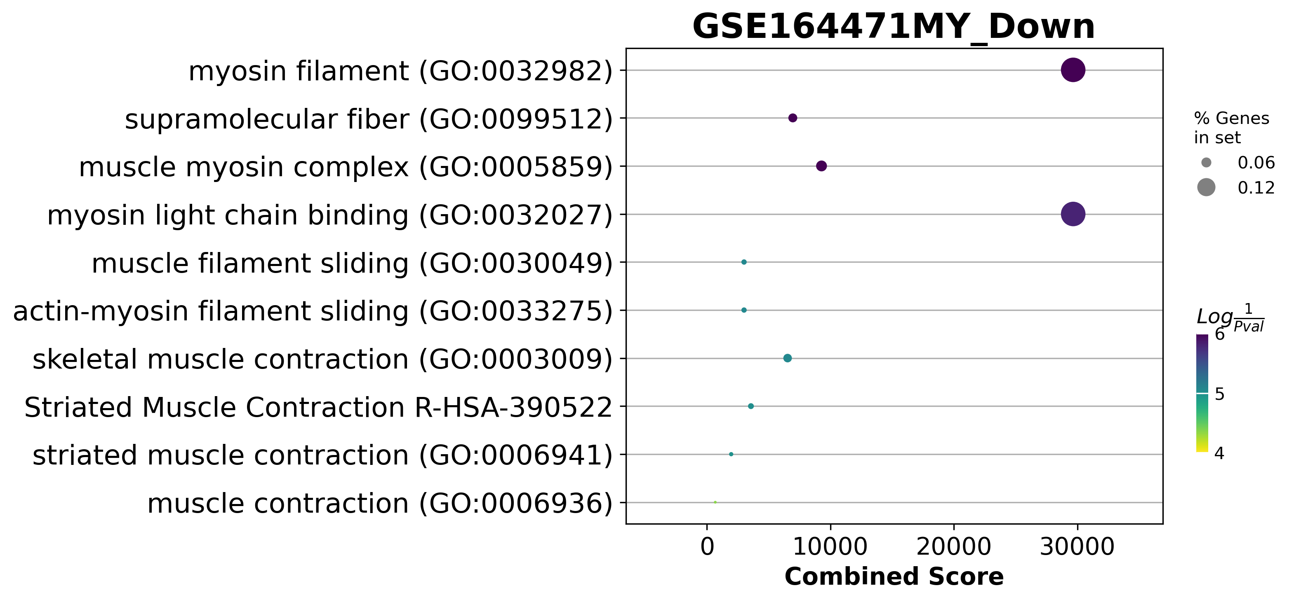
GSE164471Dotplot

Slide 22
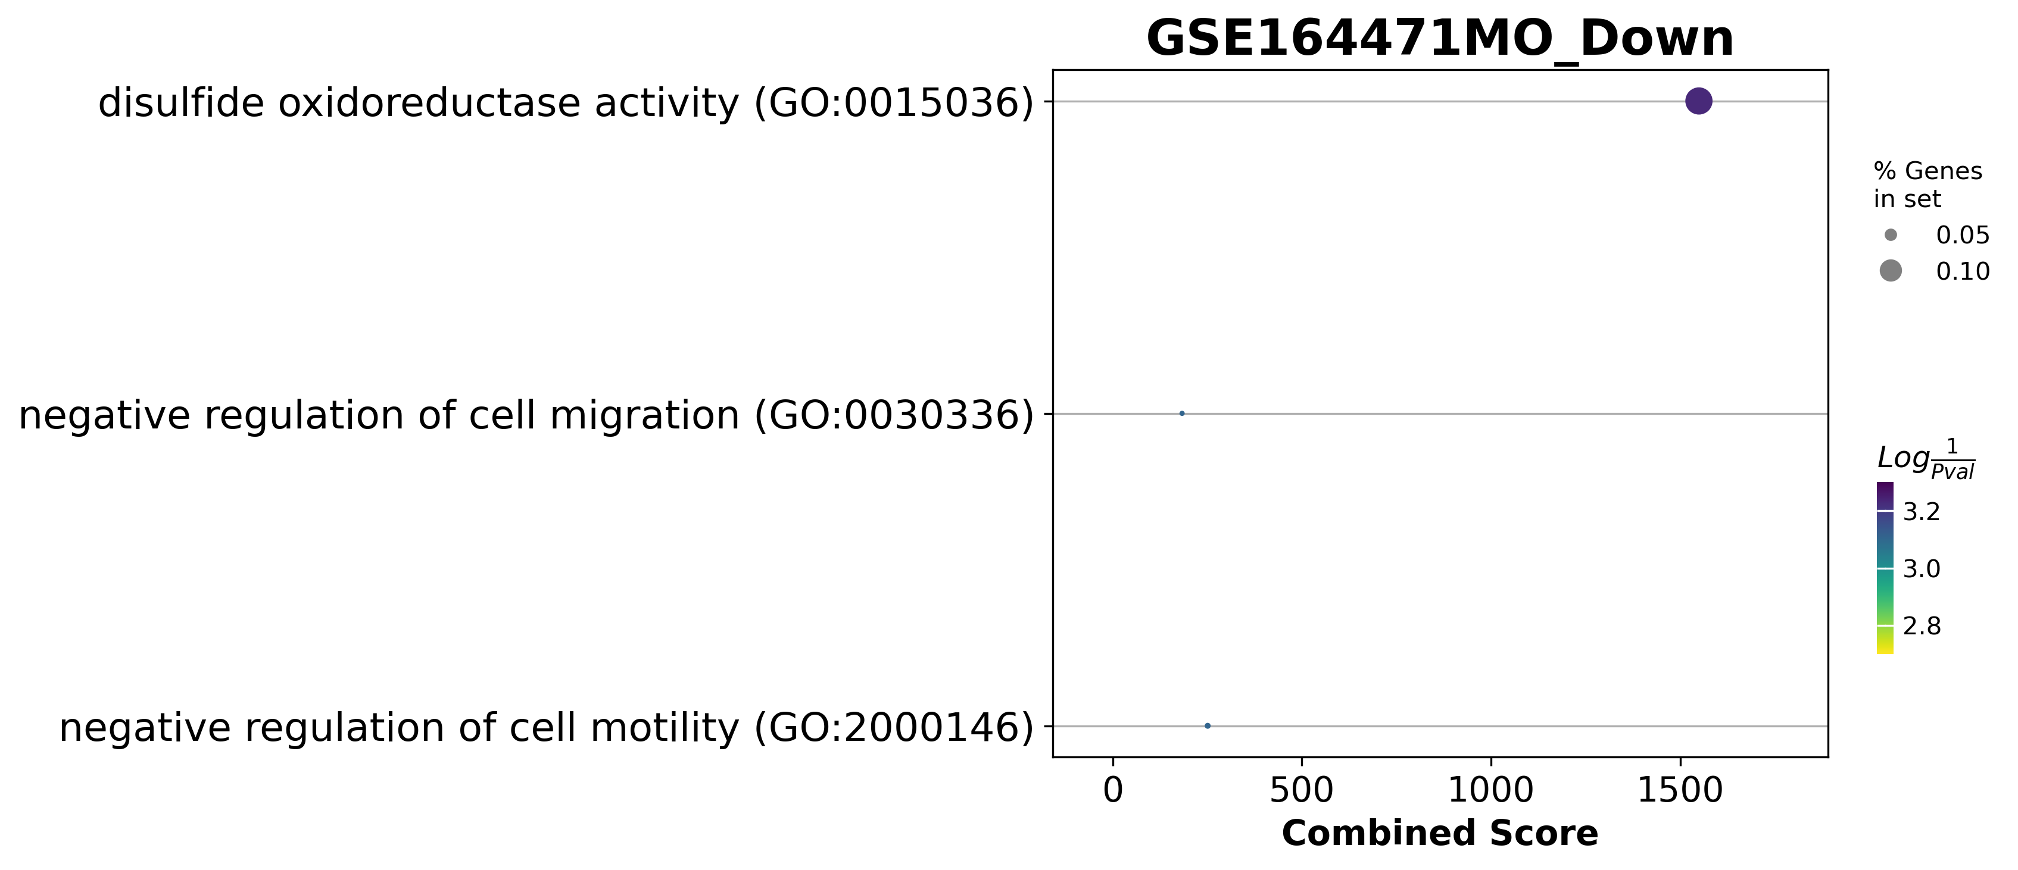
GSE164471Dotplot

Slide 23
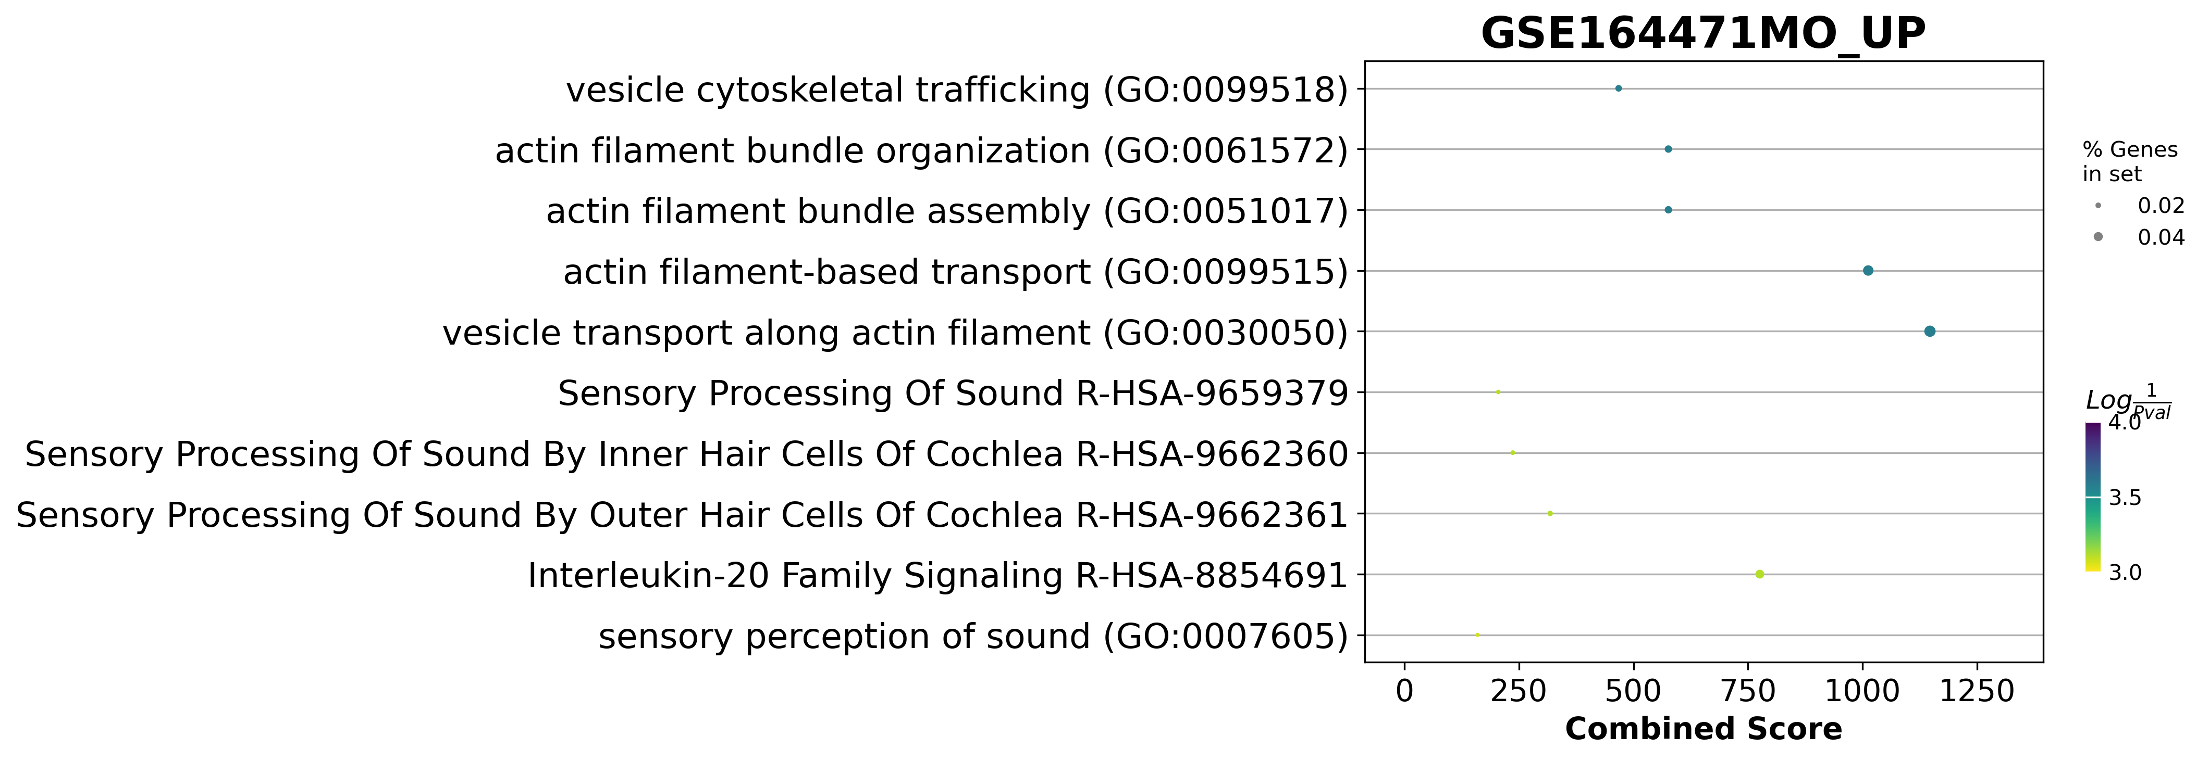
GSE164471Dotplot

Slide 24
GSE164471 was one of the best experiments
Skeletal muscle biopsies were obtained from 53 participants (22–83 years, median = 52 years)
14 Young
21 Middle age
18 Old
if they consumed medication for chronic illness
trained professionally
had a body mass index ≥ 30 kg/m2
were diagnosed with cognitive damage, a physical impairment, or a major disease.

Slide 25
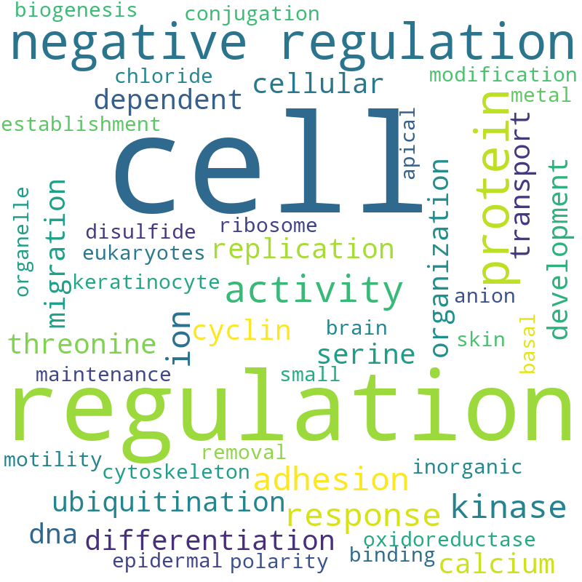
GSE164471(YO) Pathway analysis Word Cloud

Slide 26
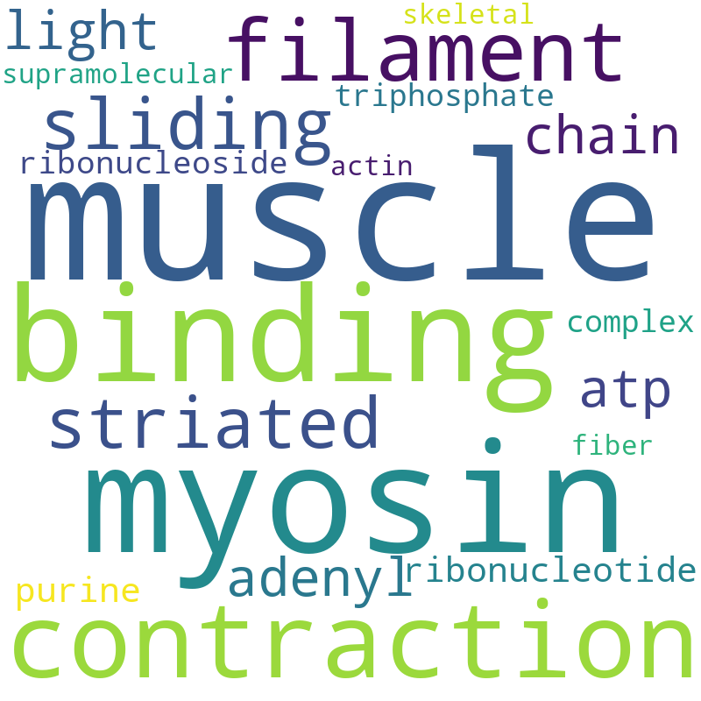
GSE164471(YM) Pathway analysis Word Cloud

Slide 27
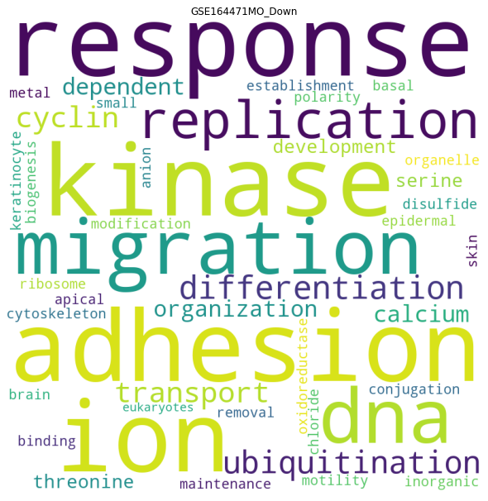
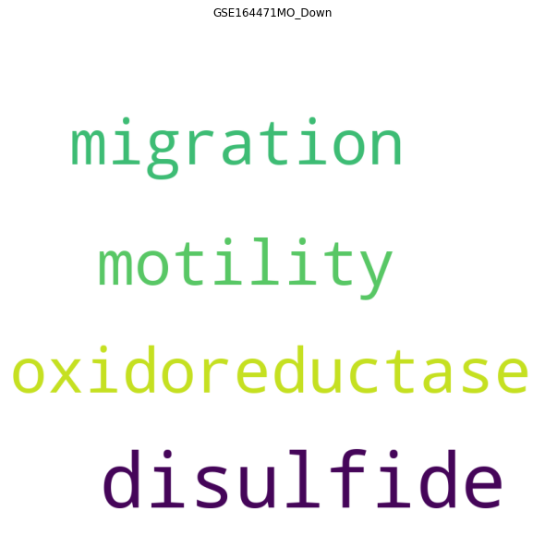
GSE164471(YM) Pathway analysis Word Cloud
Adjust p value < 0.05
Genes pathway coverture > 0

Slide 28
Differential expressed genes

Slide 29
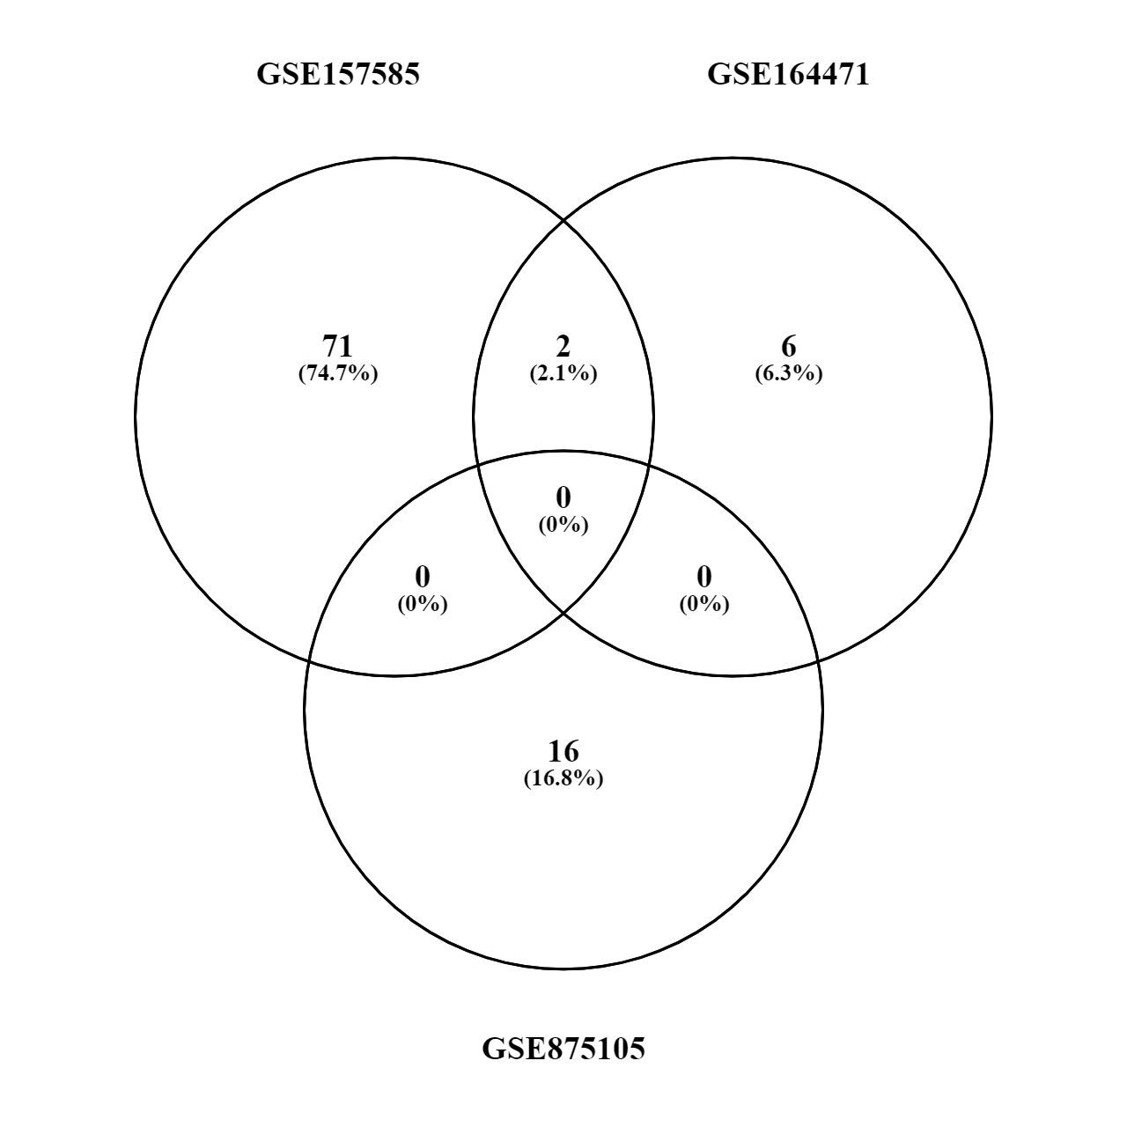
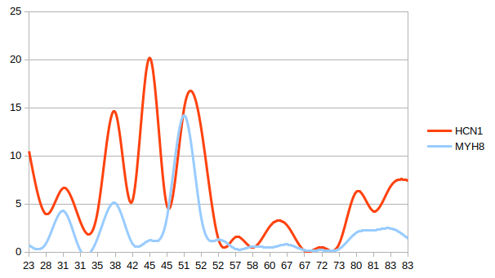
Old vs Young (up or down)
MYH8
HCN1

Slide 30
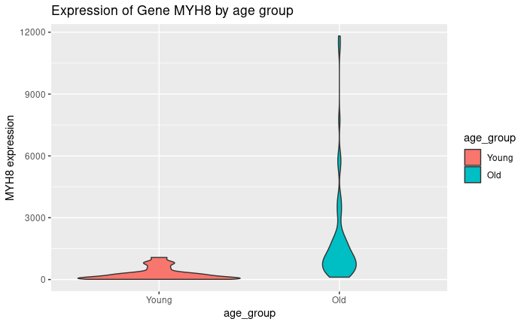
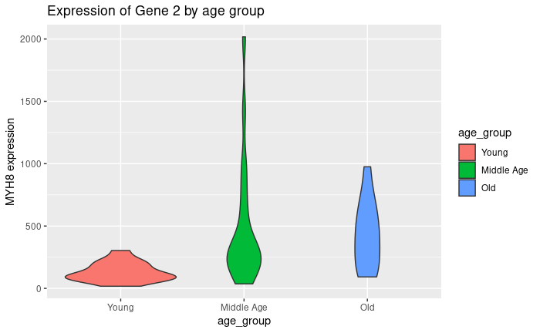
MYH8 raw count over age
GSE157585
GSE164471

Slide 31
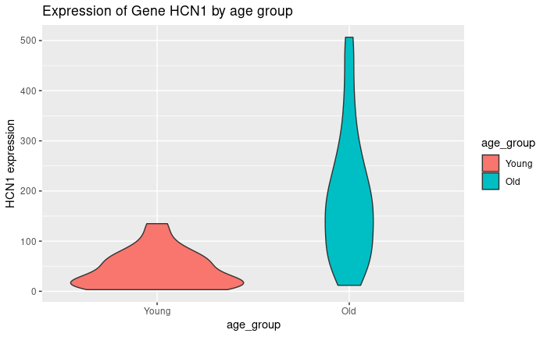
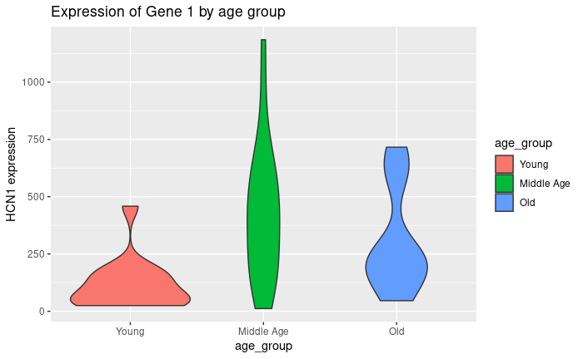
HCN1 raw count over age
GSE157585
GSE164471

Slide 32
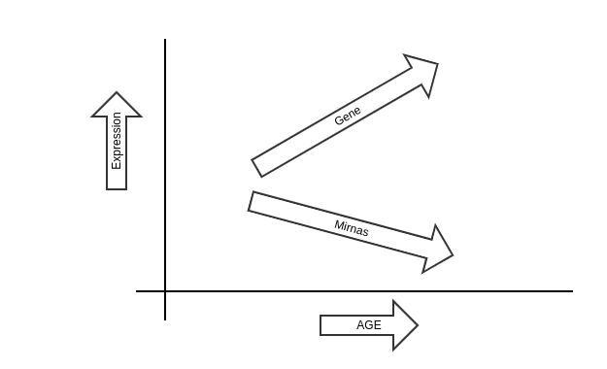
Positive slope

Slide 33
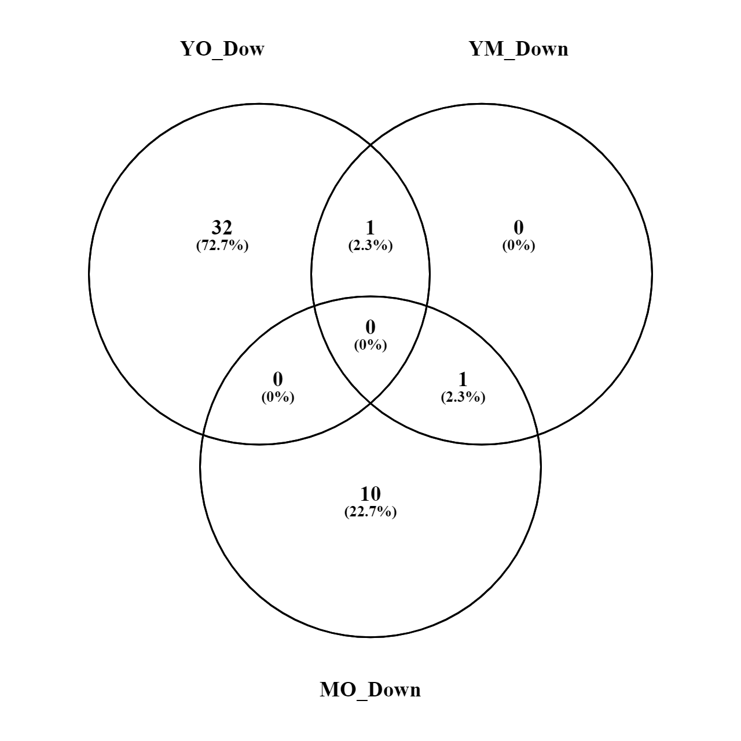
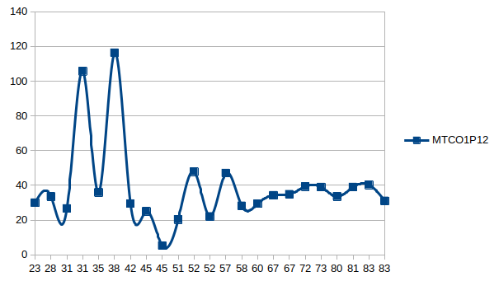
Genes increased by age
MYH8
MTCO1P12

Slide 34
Cytoscape

Slide 35
Young vs Old
YO
VS

Slide 36



Young vs Old Down-regulated
62 OG
1873 nodes
5958 edges
YO
70 OG
IntAct

Slide 37
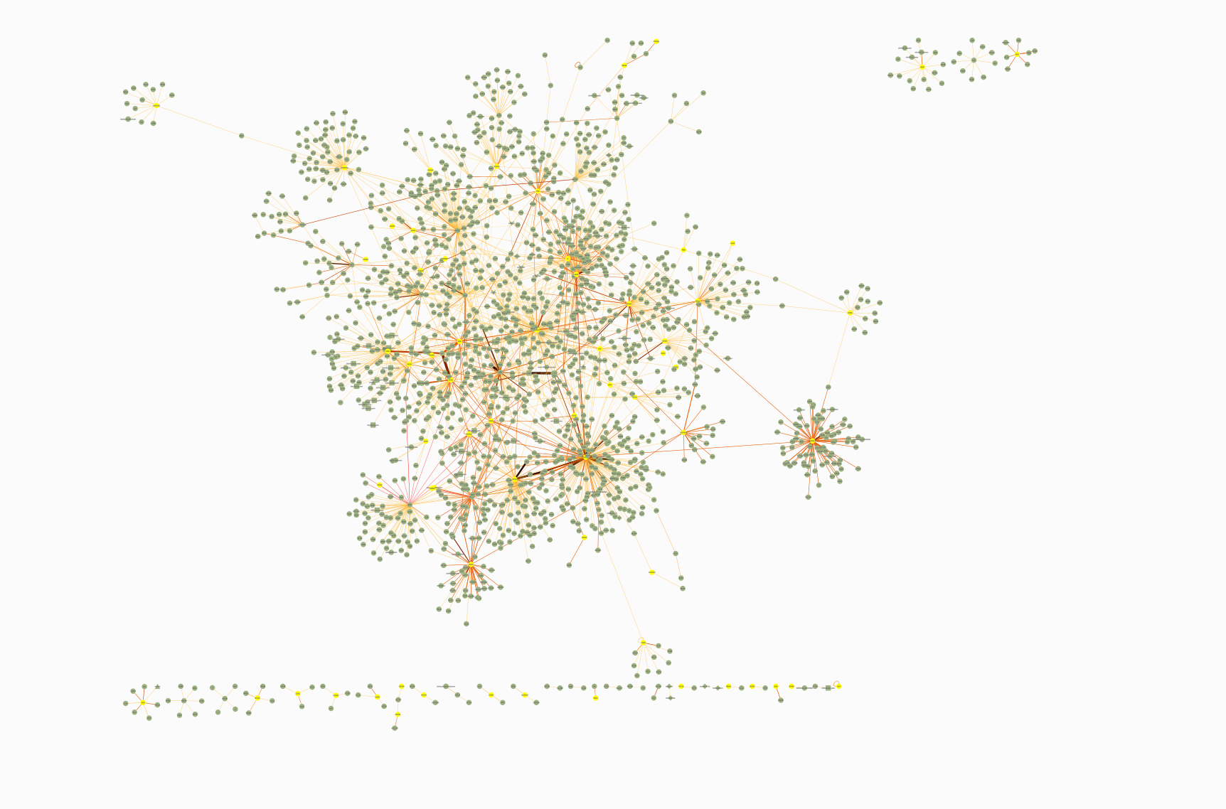
YO

Slide 38
Young vs Old Down-regulated
62 OG
1873 nodes
5958 edges
8 OG
28 miRNAs
109 nodes
287 edges
YO
70 OG
IntAct

Slide 39
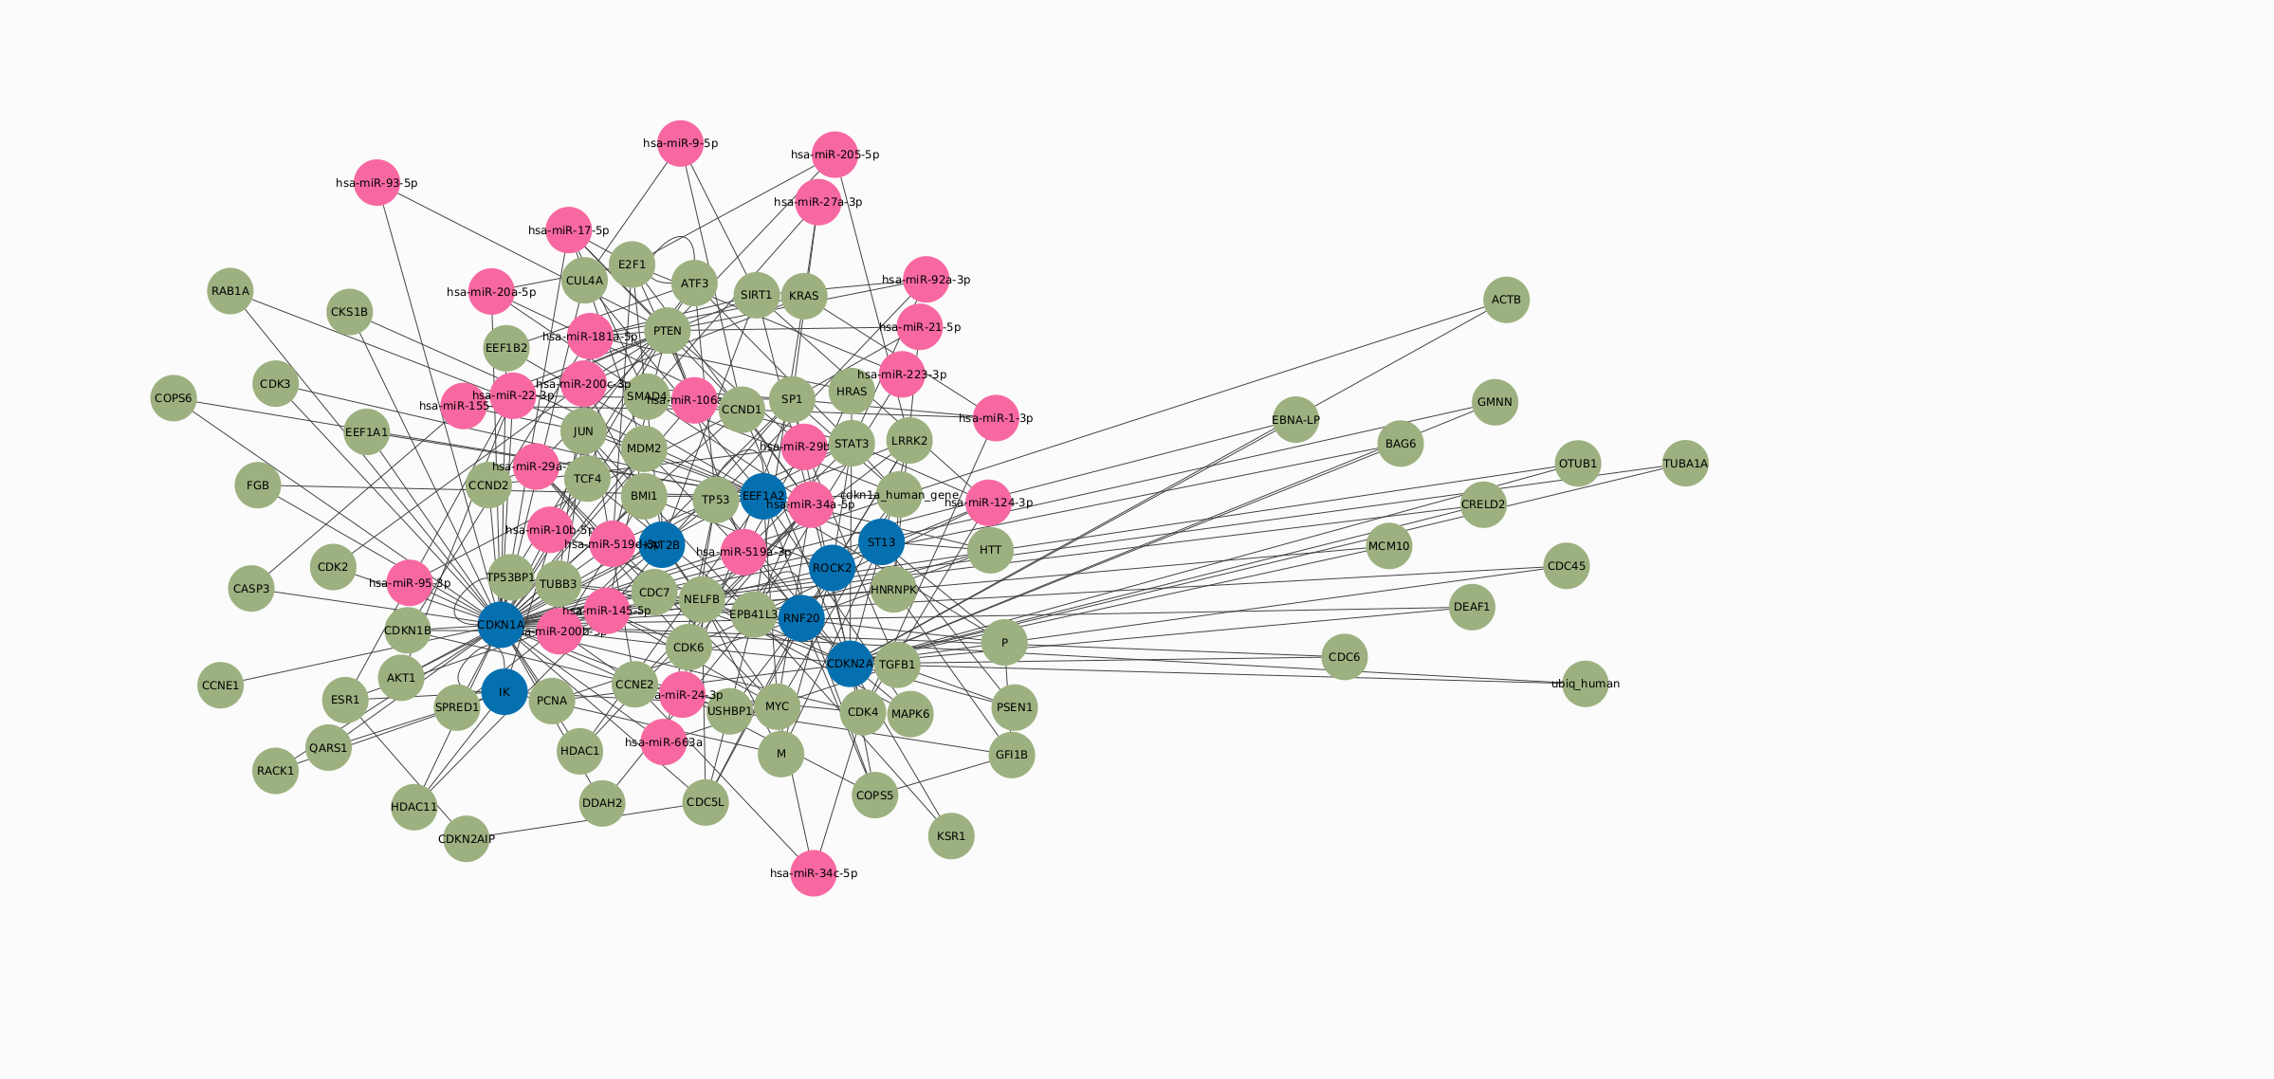
YO

Slide 40
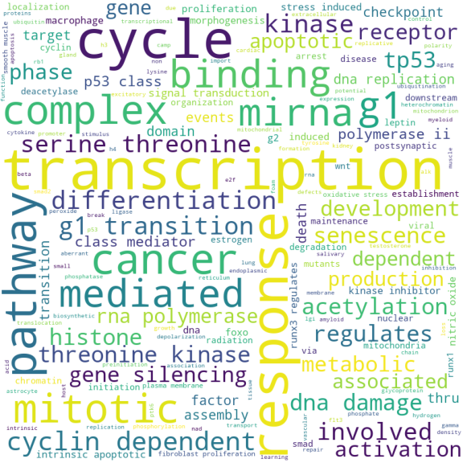
Young vs Old Down-regulated
YO

Slide 41
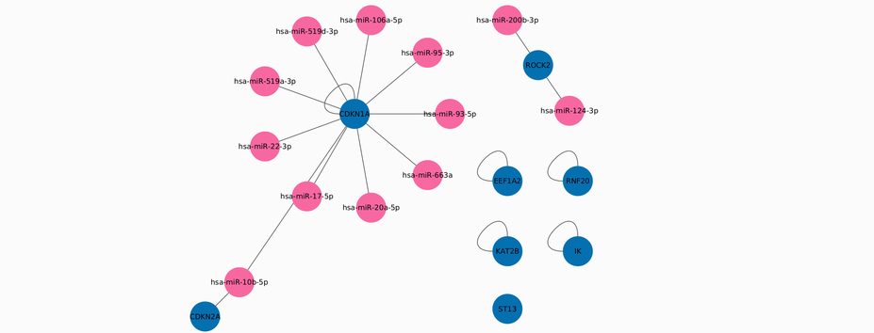
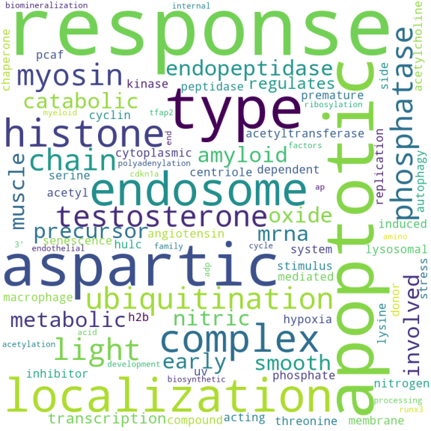
Selecting the OG genes and their connections
YO
8 OG
12 miRNAs
18 edges

Slide 42
Selecting the OG genes and their connections
YO
hsa-miR-519a-3p
hsa-miR-200b-3p
hsa-miR-10b-5p
hsa-miR-95-3p
hsa-miR-124-3p
hsa-miR-17-5p
hsa-miR-106a-5p
hsa-miR-22-3p
hsa-miR-663a
hsa-miR-519d-3p
hsa-miR-93-5p
hsa-miR-20a-5p
CDKN1A
CDKN2A
EEF1A2
IK
KAT2B
RNF20
ROCK2
ST13

Slide 43
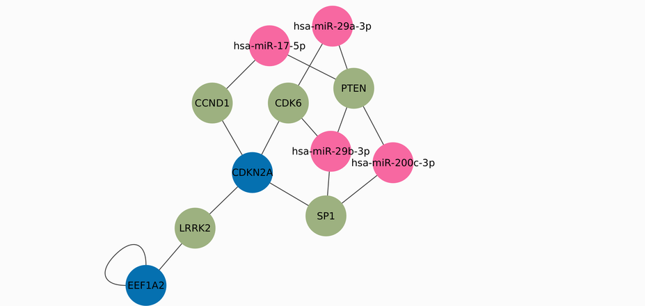
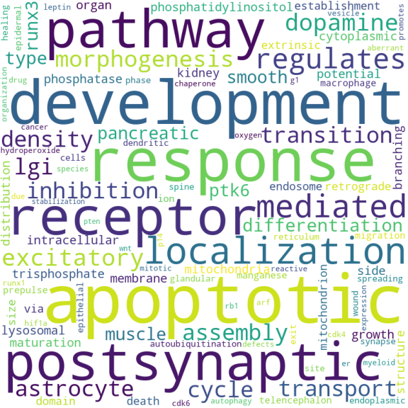
Selecting the higher connected nodes
2 OG
5 interaction genes
4 miRNAs
15 edges
YO

Slide 44
Selecting the higher connected nodes
YO
hsa-miR-200c-3p
hsa-miR-29a-3p
hsa-miR-29b-3p
hsa-miR-17-5p
EEF1A2
CDKN2A
CDK6
SP1
LRRK2
CCND1
PTEN

Slide 45
Young vs Middle Age
YM
VS

Slide 46
Young vs Middle age Down-regulated
1 OG
16 nodes
14 edges
1 OG
3 miRNAs
18 nodes
17 edges
2 OG
IntAct
YM

Slide 47
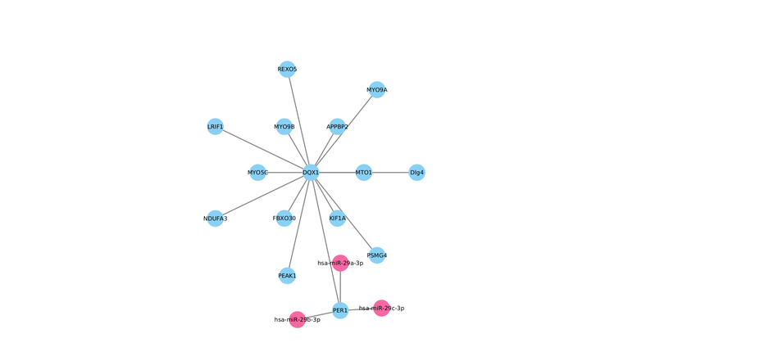
Selecting the higher connected nodes
1 OG
14 interaction genes
3 miRNAs
17 edges
YM
FAIL
hsa-miR-29a-3p
hsa-miR-29b-3p
hsa-miR-29c-3p

Slide 48
Middle Age vs Old
MO
VS

Slide 49
Middle vs Old Down-regulated
7 OG
446 nodes
1292 edges
2 OG
5 miRNAs
151 nodes
163 edges
20 OG
IntAct
MO

Slide 50
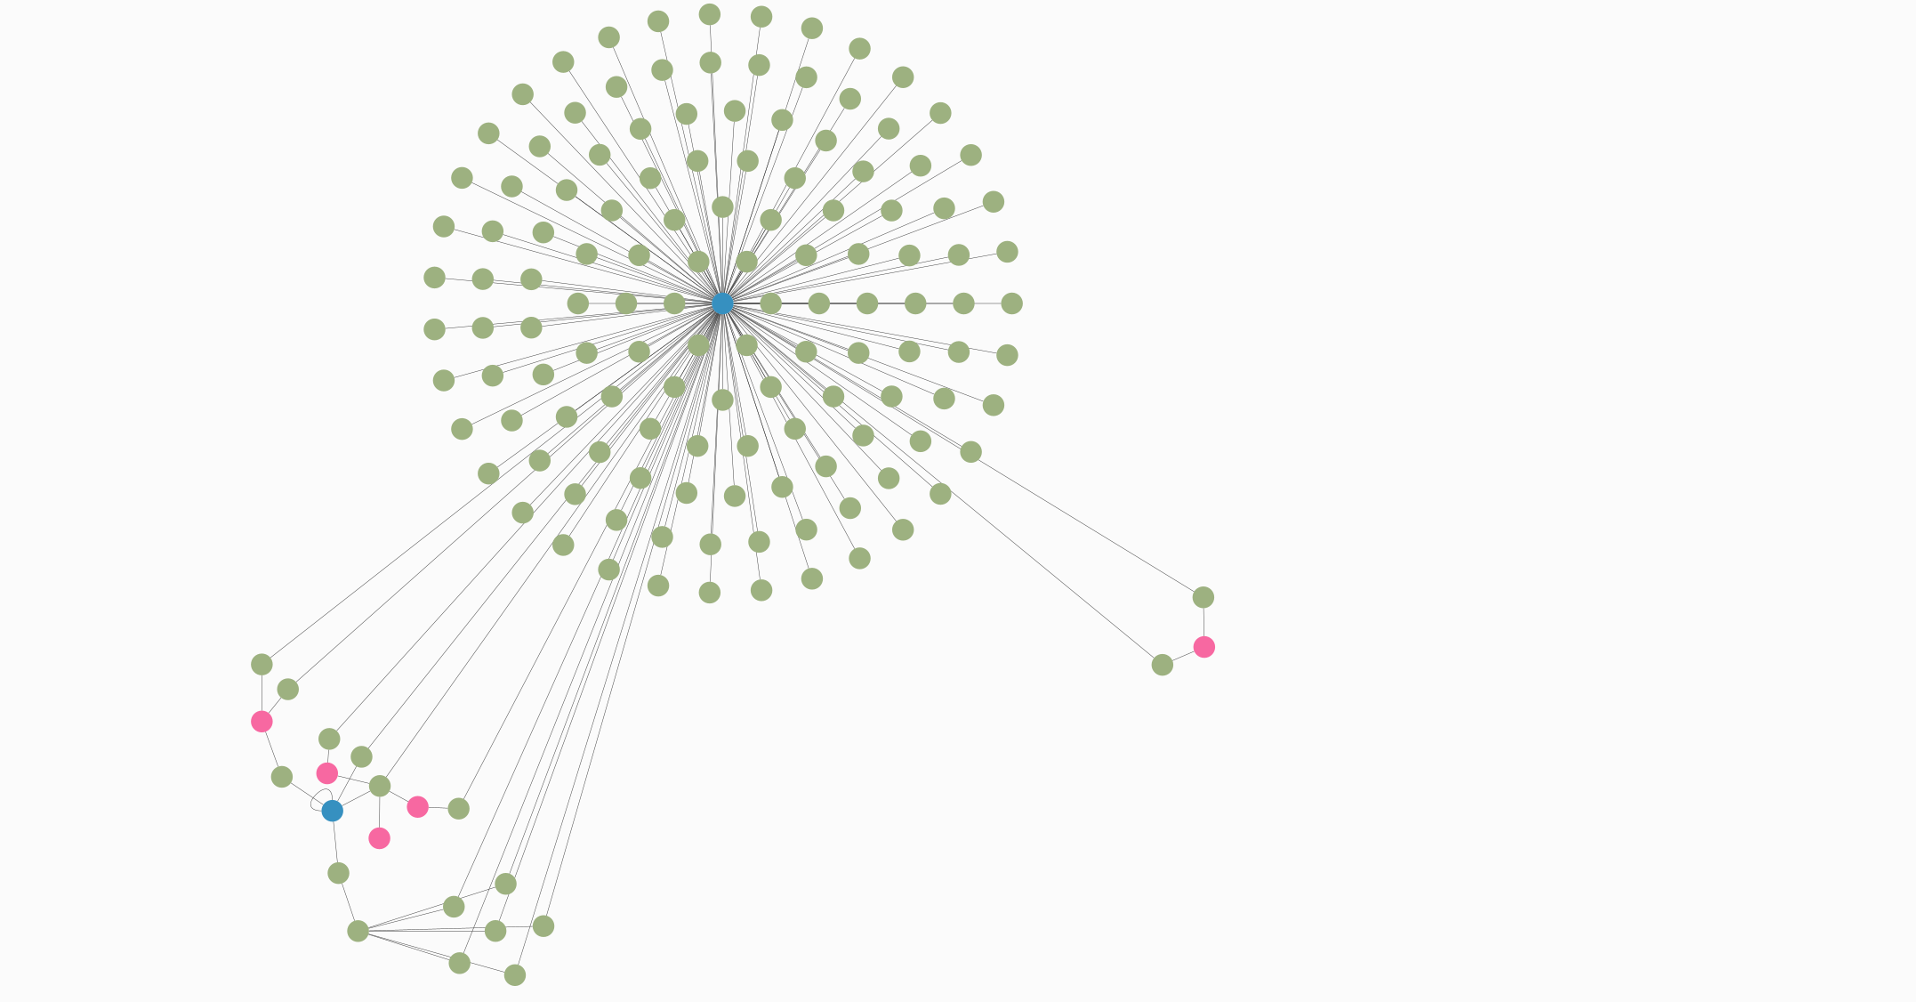
hsa-miR-124-3p
hsa-miR-137
hsa-miR-145-5p
hsa-miR-221-3p
hsa-miR-22-3p
MO

Slide 51
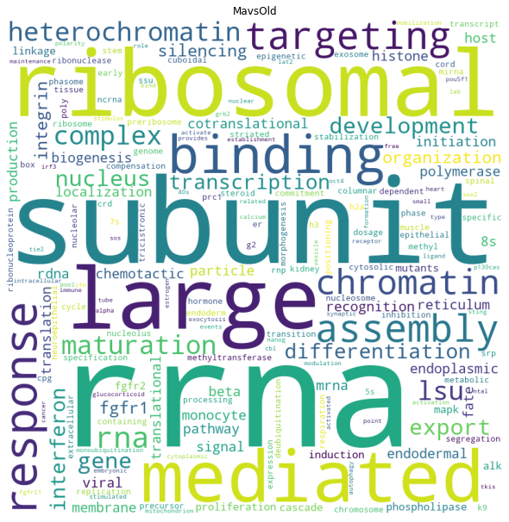
Middle age vs Old Down-regulated
MO

Slide 52
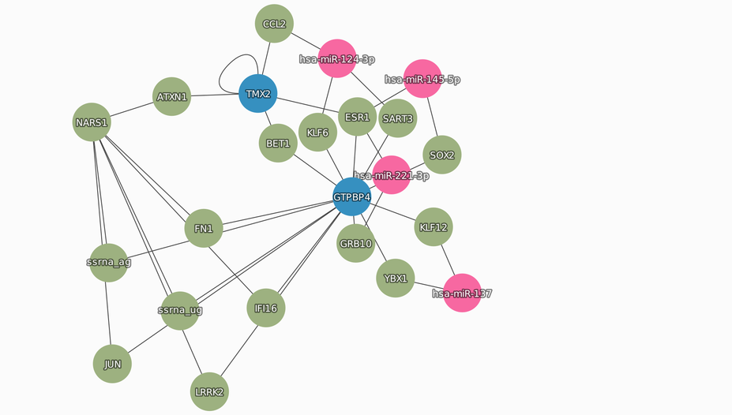
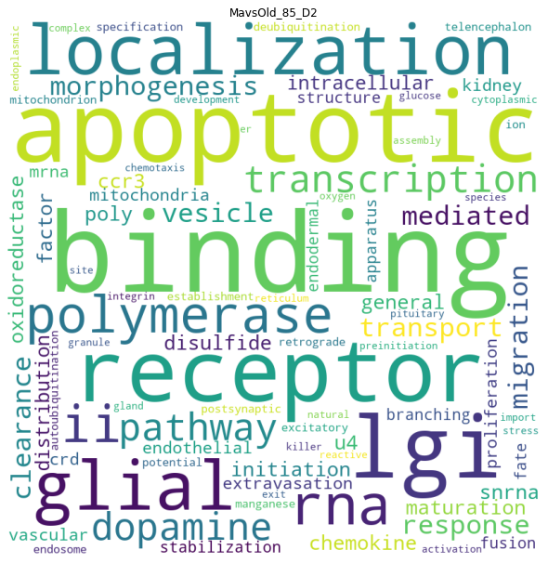
Selecting the OG genes and their connections
2 OG
2 miRNAs
19 interaction genes
35 edges
MO

Slide 53
Selecting the OG genes and their connections
hsa-miR-519a-3p
hsa-miR-200b-3p
hsa-miR-10b-5p
hsa-miR-95-3p
hsa-miR-124-3p
hsa-miR-17-5p
hsa-miR-106a-5p
hsa-miR-22-3p
hsa-miR-663a
hsa-miR-519d-3p
hsa-miR-93-5p
hsa-miR-20a-5p
CDKN1A
CDKN2A
EEF1A2
IK
KAT2B
RNF20
ROCK2
ST13
MO

Slide 54
Selecting the higher connected nodes
2 OG
5 interaction genes
4 miRNAs
15 edges
MO

Slide 55
Selecting the higher connected nodes
hsa-miR-200c-3p
hsa-miR-29a-3p
hsa-miR-29b-3p
hsa-miR-17-5p
EEF1A2
CDKN2A
CDK6
SP1
LRRK2
CCND1
PTEN
MO

Slide 56
Acknowledgements
This presentation has emanated from research conducted with the financial support of Science Foundation Ireland under Grant number [18/CRT/6214 ]

Slide 57


Slide 58
Read and get familiarize with:
TargetScan
miRNet
Enrichr
Cytoscape
PathVisio
Ingenuity Pathway Analysis
Complex Pathway Simulator
GENE Expression Omnibus
Xpress

Slide 59
Thank You

Slide 60
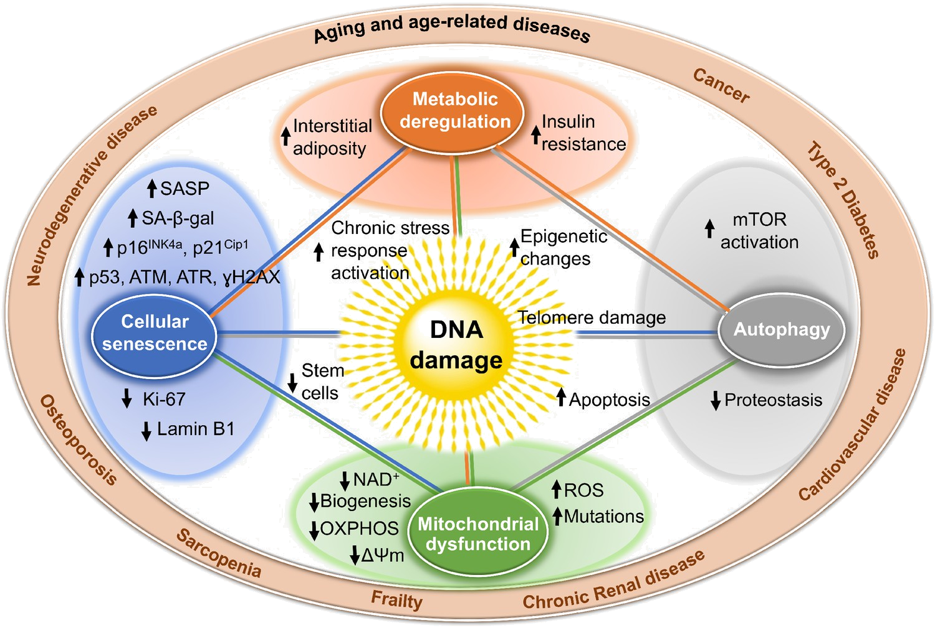
Why miRNAS
Notes:
Well, Aging is the cause of Sarcopenia, but this involves plenty of different processes that make it complicated to approach by isolating one pathway or one gene. And using small molecules work as a preventive method, they don’t regenerate the muscle. , microRNA allows a cleaner approach, because we can know the target and escalate to more parts of the body.

Slide 61
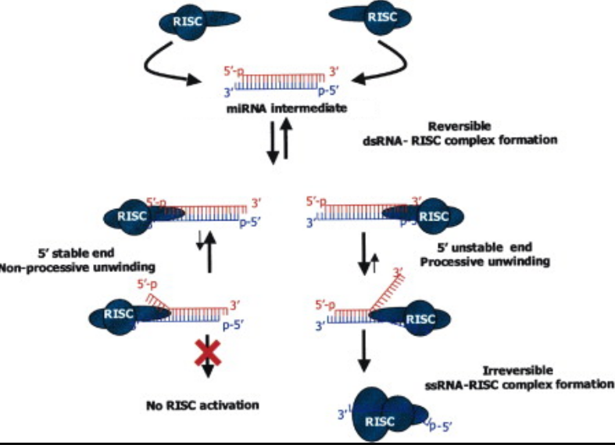
miRNA duplex
Notes:
Edited from https://www.cell.com/fulltext/S0092-8674(03)00801-8

